Slide 1
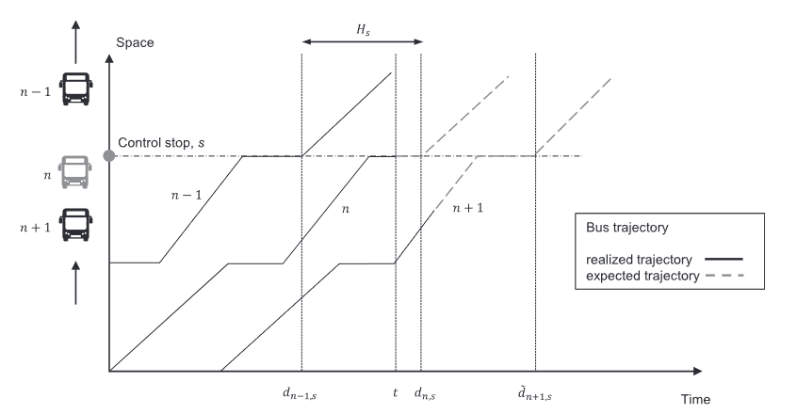
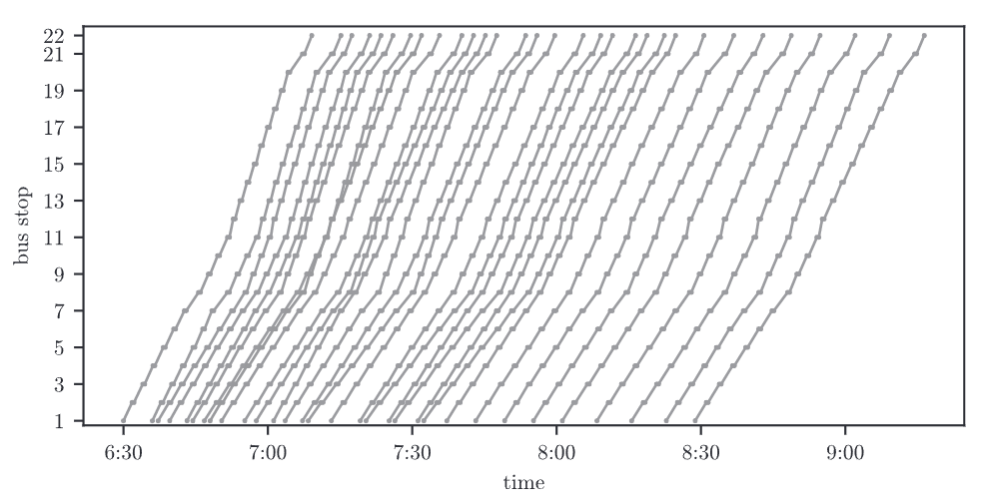

Dynamic bus headway control to reduce bus bunching with travel time prediction and smart card data Researcher: Taehyung Kim
What is the problem?
Occurrence of Bus bunching: Several buses running on the same route arrive at the bus station simultaneously
When bus bunching occurs, an overcrowded bus is usually followed by a near-empty bus which leads to wasting the limited resources and increasing the operation costs for transit companies
Bus bunching leads to inefficient operation and increased waiting time for passengers
Simply adjusting the headway by current time interval of the bus ahead/following can lead to bunching
Why is this problem important?
The emergence of bus bunching severely deteriorates the quality of transit service and increases passenger waiting time with uneven passenger loadings
Bus bunching is undesirable given that it creates inefficiencies and can push passengers to use private transport
Because of continuously changing demand and link flow over time, dynamic headway control using prediction of link travel time and demand on each stop is essential to prevent from bunching happening
How can we solve this problem?
Providing real-time desired headway that minimizes total stop-level headway difference
Evaluate predictable delays by using the prediction of link travel time between the bus stops and the historical smart card data about the number of passengers boarding/alighting at each bus stop
Previous studies on reducing bus bunching used holding, signal control, skip-stop, boarding limitation, overtaking, etc.
Bus
bunching
Bus n + 1
Bus n
Bus stop
a
Link ab
Bus stop
b
Link bc
Bus stop
c
Link cd
Bus stop
d
Link de
Bus stop
e
From prediction of link travel time
▽
Prediction #1: Congestion occur on link cd
about the time when bus n+1 comes
▽
(Link travel time of bus n+1) > (Link travel time of bus n)
From historic smart card data
▽
Prediction #2: Increase of number of passengers
waiting on bus stop d about the time when bus n+1 comes
▽
(Boarding time of bus n+1) > (Boarding time of bus n)
According to the predictions above, bus n+1 and bus n+2 might lead to the state of bunching
What is key contribution?
Proactive countermeasures of bus bunching before bus service failure
Easily applicable bus bunching reduction method by implementing link travel time prediction and demand prediction

